Slide 1

APP Leadership Training
Adapted from Stanford University’s APP Continuing Education

Slide 2
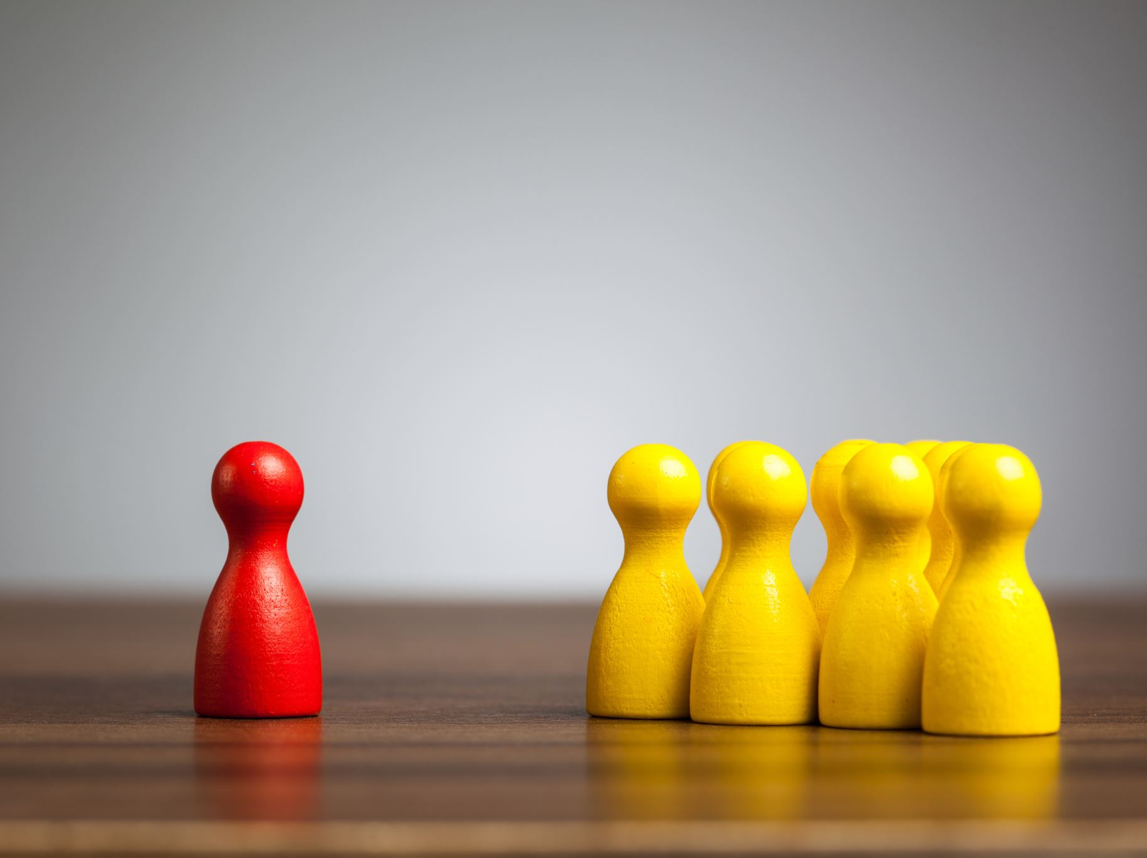
Conflict Management
Notes:
What do you do when people have differing ideas?
When this happens - we take things personal, and emotions rise.

Slide 3
Learning Objectives
Learn to promote diversity
1
Manage participation in meetings
2
Improve knowledge of others’ competences
3
Notes:
Encourage people to express differences and navigate this
Openness to ideas, trust, emotions do not get high, willing to be flexible, presume good intent
"Conflict is caring"

Slide 4
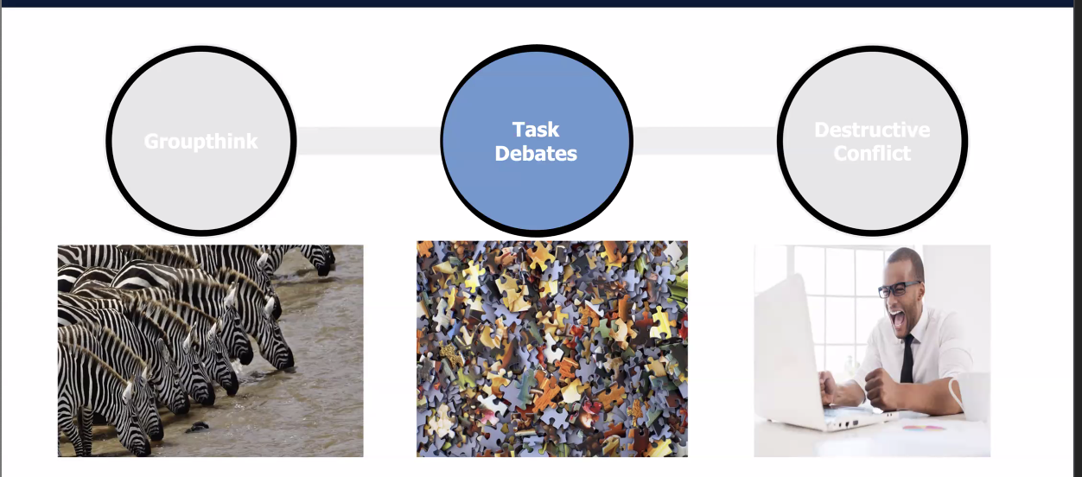
Debate = GOOD Conflict
Book recommendation: Think Again by Adam Grant
Dr. Lindy Greer
Notes:
How do you keep things in the middle zone?
Remember disagreement in debate with conflict is valued. This helps to actively share different ideas.
So how can we get people to agree and disagree?

Slide 5
Tools for promoting task-orientated debates
Composition: when possible, choose members who bring different perspectives relevant to the team task
Agendas: build debate into the agenda (with a time stamp) and consider using more question marks in your agendas
Rotating devil’s advocate: encourage the discussion of minority opinions
Blue team vs Red Team: for big decisions split the team in 2 and formalize a true 2-sided debate
Equal participation: ensure all voices are heard
Strive for shared impact: look for win/win and yes-and then reconstruct ideas
Notes:
Inclusion = shared sense of belonging and sharing difference
-How we belong is based on your value in the team
-We are a team first and end: whatever happens in the meeting does not leave outside the room
How do you keep expectations aligned during the meeting?
-acknowledge and redirect

Slide 6
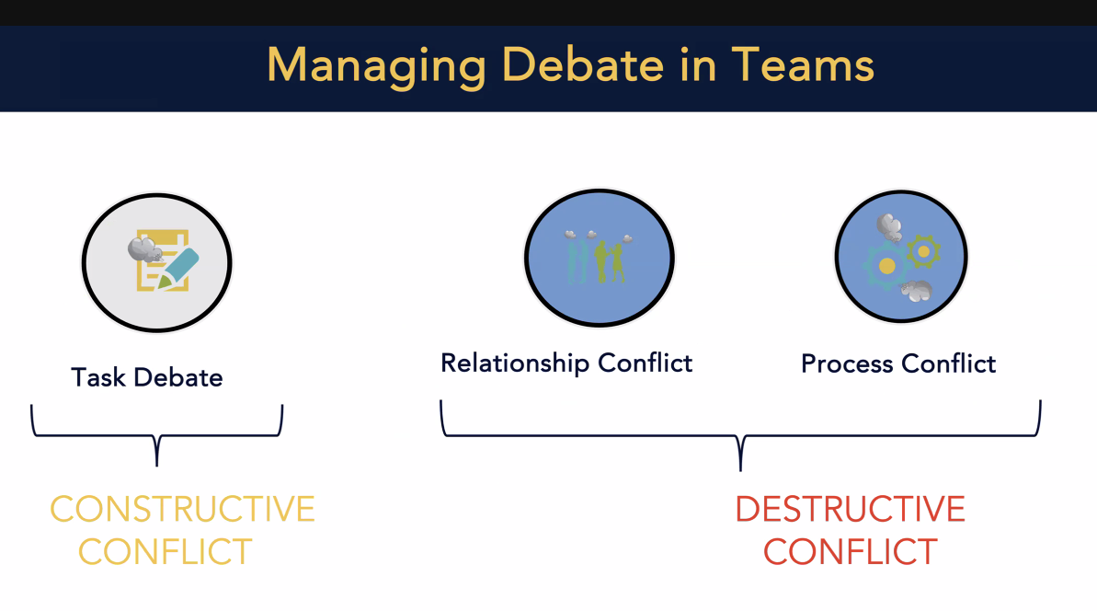
Dr. Lindy Greer
Notes:
Destructive conflicts
-it turns personal
-fighting over a stupid issue that comes up each meeting
-what you are fighting about is not the real issue (eg. What time to meet? The real conflict may be I'm a parent and cannot meet at that time and as a parent I am never allowed to be a parent in this institution.)
-if you see it escalate: stop it, course correct by redirecting
What can we do to not offend someone or create reactivity?

Slide 7
Support constructive team debates
Develop
Develop psychologically safe environment
Presume
Presume good intent
Prioritize
Prioritize informed knowledge/data
Manage
Manage emotions – yourself and others
Be
Be aware of timing and content
Choose
Choose words wisely: rely on hypothesis, observations, and questions
Notes:
Psychologically safe environment includes all voices. Highlights shared interests and common values towards a team goal.

Slide 8
Emotions rise
Step one
Manage your own emotions
Breathe before you engage
Think yourself in the 3rd person
Hold warm tea, coffee, water to ground you
Wait to engage until you are calm
Step two
Someone else is being emotional
Ask yourself: “what am I missing here?”
Be curious and feel teachable
Acknowledge the emotion: what are you feeling here…is it feeling tense…
Step three
Reframe: Let me understand what you are saying
Keep it to data; not opinion

Slide 9
Remember…LARA Framework?
Listen
Acknowledge
Respond
Add new divergent information
Notes:
Listen: “Could you walk me through your thinking on this?...”
Acknowledge the other person’s views:
“I understand that ...”
“I believe what you’re saying is...”
Respond and Add - Create ‘yes-and’ opportunities that construct a solution by integrating ideas rather than deconstructing others. “I agree that risk is an important factor here. Here’s something we can consider in that lens…”
Seek to understand before being understood
Often times they have the same opinion as you do
When you communicate back you can be better understood
Adapt our wording to meet others where they are at

Slide 10
LARA’s Help in Task-oriented Debate
LISTEN: “Could you walk me through your thinking on this?”
Acknowledge (the other person’s views):
  “I understand that…”
  “I believe what you’re saying is…”
Respond and Add
  “Yes AND opportunities”
  “I agree that risk is an important factor here. Here’s something we can consider that lens…”

Slide 11
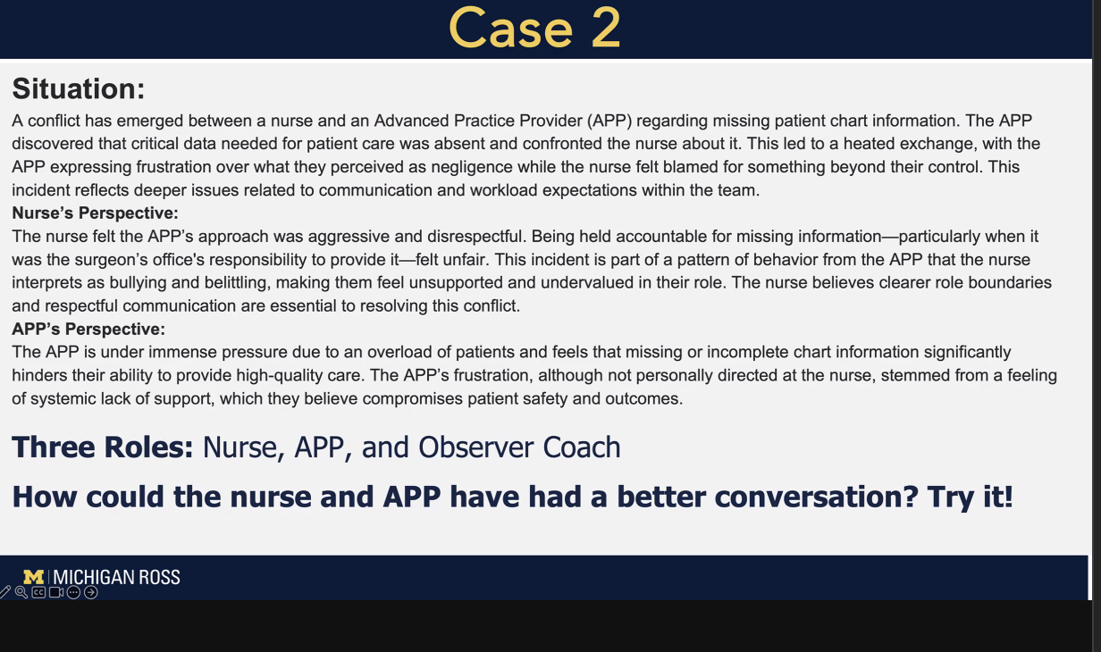
Dr. Lindy Greer

Slide 12
Take aways
Foster debate
Ensure diverse team
Put debate into the agenda
Formalize a role, like devil’s advocate
Structure debate: red vs blue team
Keep debate civil
Presume good intent
Highlight common values
LARA
Create safe environment
Manage emotions
When things escalate
Validate emotions
Unpack underlying issues
Give constructive feedbacl

