Slide 1
APP Leadership Training Adapted from Stanford University’s APP Continuing Education

Slide 2
Team Development
Activity session break out
Notes:
Team Development: Murder Mystery
Situational Leadership
Project Proposals

Slide 3
Team Design
Team Design
Tools/Behaviors
Leverage agendas
Everyone to speaks
Presume different information
Number needed to decide
4 - 5
Notes:
How would I design this team?
What tools/behaviors do I have to nudge them to be engaged?
Leverage agendas
We allow everyone to speak - create safe place to speak
Presume that people come with different information
How many people do you need in a meeting to make the BEST decision? Research says 4-5 people is best.

Slide 4
How to design the best team?
Step One
"What is the goal?"
Step Two
"Who really needs to be in the room?"
Step Three
"Who has the best information?"
Notes:
Brainstorming works better in a Google Doc - don't need a meeting for brainstorming
Once you have ideas, choose 3-4 people to go over that document

Slide 5
Room Diversity
Become
quiet & listen
Everyone has a voice
Timing of lead speaking = end
Assign a position*
Notes:
Diversity is good, but it is hard - these teams make higher quality decisions.
Timing of lead speaker should be at end after everyone else speaks so they can summarize and reflect out

Slide 6
Assign a position: Solve the diversity challenge
Composition
Agendas
Rotating devil’s advocate
Red team, Blue team
Notes:
Why we care about diversity? Majority or consensus decision making leads to subpar decision making
Composition – when possible, choose members who bring different perspectives relevant to the team task
Agendas – build debate into the agenda (with a time stamp) and consider using more questions marks in your agendas
Rotating devil’s advocate – encourage the discussion of minority opinions
Red team, Blue team – for big decisions split teams in 2 and formalize a true 2-sided debate

Slide 7
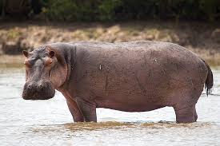
Manage participation
Hierarchy flexing
Be a HIPPO – set the flex
Out of water to kick it off
In water during meeting
Out of water makes decision
Notes:
How do we ensure all voices are hear?
Hierarchy hurts!
Once meeting begins no hierarchy exists - all voices matter.
This is called hierarchy flexing.
Highest position possible - sets the standard for flexing.
HIPPO
Out of water to kick it off: rotate meeting control by expertise
In water during meeting: listen and facilitate
Out of water makes decision

Slide 8
Managing voices
Quiet voices
Loud voices
Flatness
Notes:
How to manage quiet voices:
Actively facilitate that person to participate by calling on them to give their opinion. "I am trying to speak less, so I am going to let everyone else speak before I do today.”
How to manage louder voices:
Speak to them before the meeting and let them know they can voice their opinion to you and you can bring their thoughts into the conversation.
Sit them into a less visible position in the room.
Move eye gaze to another person.
Flatness:
As a leader, ask more questions.
As a leader, let them know you are running an experiment, and ask for feedback.

Slide 9
LARA Framework
Listen
Acknowledge
Respond
Add new divergent information
Notes:
Listen: “Could you walk me through your thinking on this?...”
Acknowledge the other person’s views:
“I understand that ...”
“I believe what you’re saying is...”
Respond and Add - Create ‘yes-and’ opportunities that construct a solution by integrating ideas rather than deconstructing others. “I agree that risk is an important factor here. Here’s something we can consider in that lens…”

Slide 10
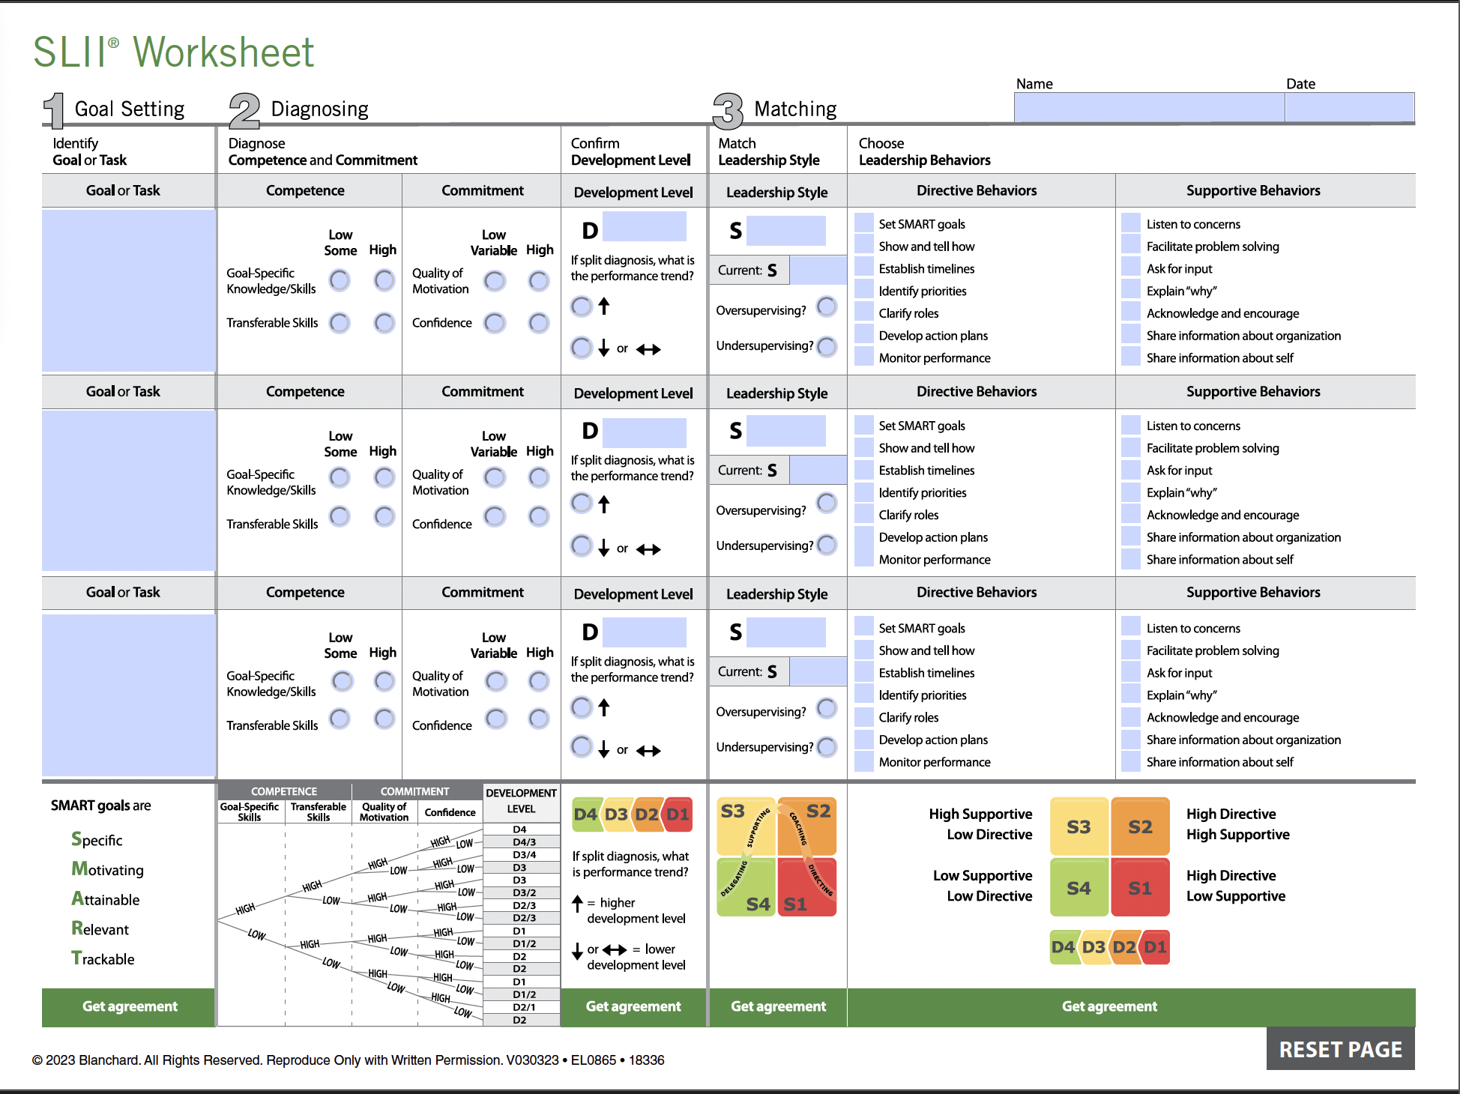
Situational Tools
Notes:
Print this Worksheet

Slide 11
Notes:
Print this packet – ask to read and we can discuss next session

Slide 12
Case Example
Situation: The Advanced Practice Providers (APPs) at a large outpatient clinic are concerned about the number of patients they are expected to see daily. After discussions, they concluded that seeing 12 patients per day allows them to maintain high-quality care, thorough evaluations, and manage non-billable tasks like follow-ups and documentation. They fear that increasing the load compromises patient safety and satisfaction.
However, the administrative team, led by a Non-Provider Administrative Staff Lead, has introduced a new schedule template requiring 16 patients daily to ensure financial sustainability. This decision, made without consulting the APPs, is based on financial data and benchmarking against other clinics. Set to be enforced in two weeks, the change has created unrest and frustration among APPs, who feel it undermines their professional role and understanding of patient care complexities. This scenario calls for a mediated conversation to address these concerns.
Impact:
Divide Between APPs and Administration: The decision has created a rift between the APPs and the administrative team.
Administrative Perspective: Administration is under pressure to ensure financial viability and meet budgetary goals. They view the APPs' resistance as unwillingness to adapt.
Potential Consequences: If unresolved, this conflict could decrease morale, increase turnover, and negatively impact patient care and satisfaction.
Notes:
Three Roles: APP lead, Non-Provider Administrative Staff lead, and Observer Coach
What would you do? Walk through a conversation together.

Slide 13
When things escalate…
Validate emotions
Engage in relational repair
Unpack underlying issues
Notes:
Relationship repair - reinforce relationship, good intent, shared values, presume good intent, offer constructive feedback
If time or set up another meeting: Unpack underlying issues causing process conflicts, and prevent them through equitable processes and energy checks

Slide 14
Receiving Feedback
Receive
Notice, name, and manage your emotions.
Engage in conversation to better understand.
Don’t argue, just say thanks.
Reflect
Evaluate it, slowly, looking for what might be right.
Check in with others to validate.
Respond
Develop and execute a self-change plan.
Check back in with your feedback giver.

Slide 15
Project Proposals!

