Slide 1
Non Tuberculous Mycobacterial (NTM)
Lung Disease
Diagnosis and treatment trends
Jennifer Faber-Gerling
RN MS ACNS NP-BC

Slide 2
Disclosures
Insmed: speaker bureau/advisory board
Notes:
During this presentation you will hear about Amikacin Liposomal inhalation suspension (ALIS/Arikayce) which is the only FDA approved antimicrobial for refractory MAC

Slide 3
Objectives
Overview of NTM Pulmonary Disease
Guideline update
Review management of MAC Pulmonary Disease
Review management of M. abscessus Pulmonary Disease

Slide 4
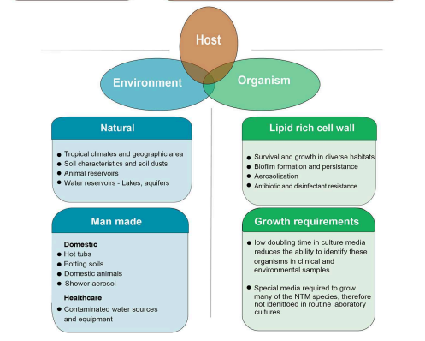
NTM exposure
.
Ratnatunga CN et al. Front Immunol. 2020
Notes:
Coastal regions
Industry
Surface-interface between water and air
Routine sterilization procedures do not work example diagnostic tools like bronchoscopy

Slide 5
Pulmonary NTM infection
Structural/functional lung compromise
Genetic Acquired
Cystic Fibrosis Bronchiectasis
Alpha-1 antitrypsin deficiency COPD
Primary Ciliary dyskinesia Chronic aspiration
Pulmonary alveolar proteinosis Lung malignancy
Lady Windemere syndrome Drug induced Other
Post menopausal, Anti-TNF therapy Vitamin D deficiency
thin, female Cytotoxic therapy Aspergillus infection
and skeletal abnormalities Steroid therapy (ABPA)
Ratnatunga CN et al. Front Immunol. 2020
Notes:
LWS-Phenotype description of… skeletal abnormalities include pectus excavatum and scoliosis
Define bronchiectasis

Slide 6
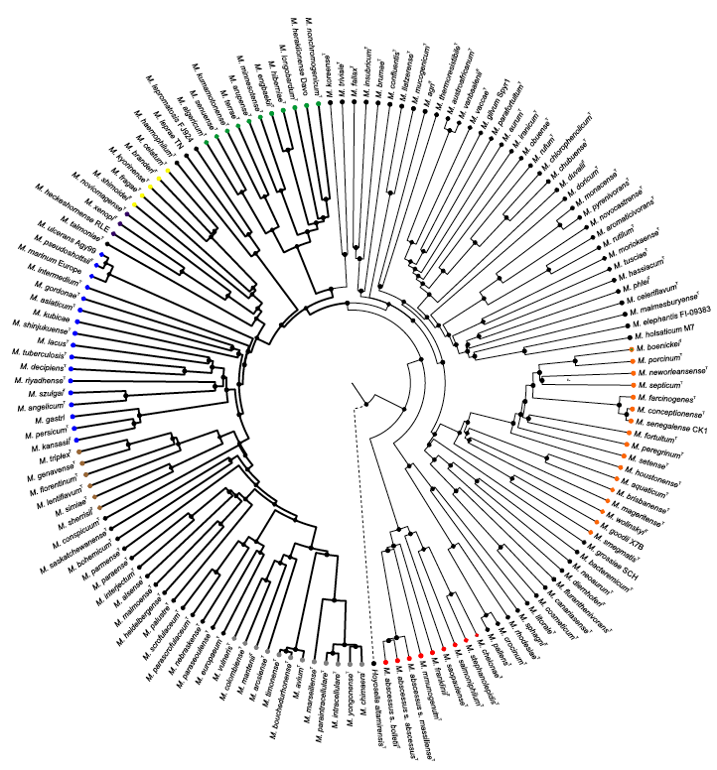
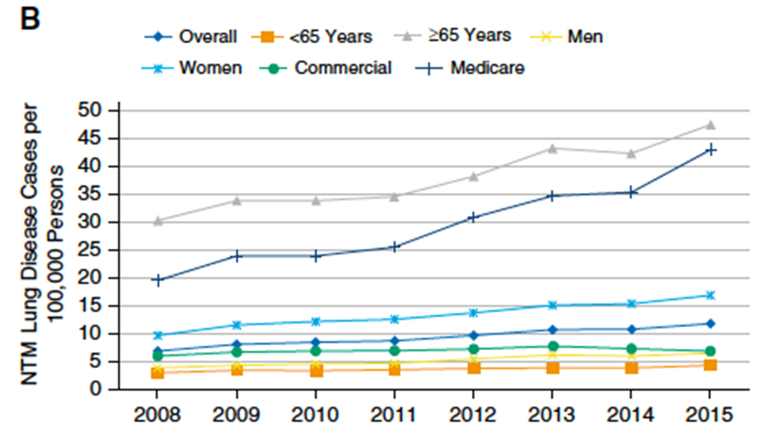
Nontuberculous Mycobacteria (NTM)
An Increasing Cause of Pulmonary Disease
National Managed Care Claims Database – 27 million people annually
Prevalence (per 100,000)
∽200 species
Tortoli E, et al. Inf Gen Evol 2017;56:19
Winthrop KL, et al. Ann Am Thorac Soc. 2020;17(2):178‐185.
Notes:
There are several epidemiologic studies showing increase of NTM, per graph 40/100,000

Slide 7
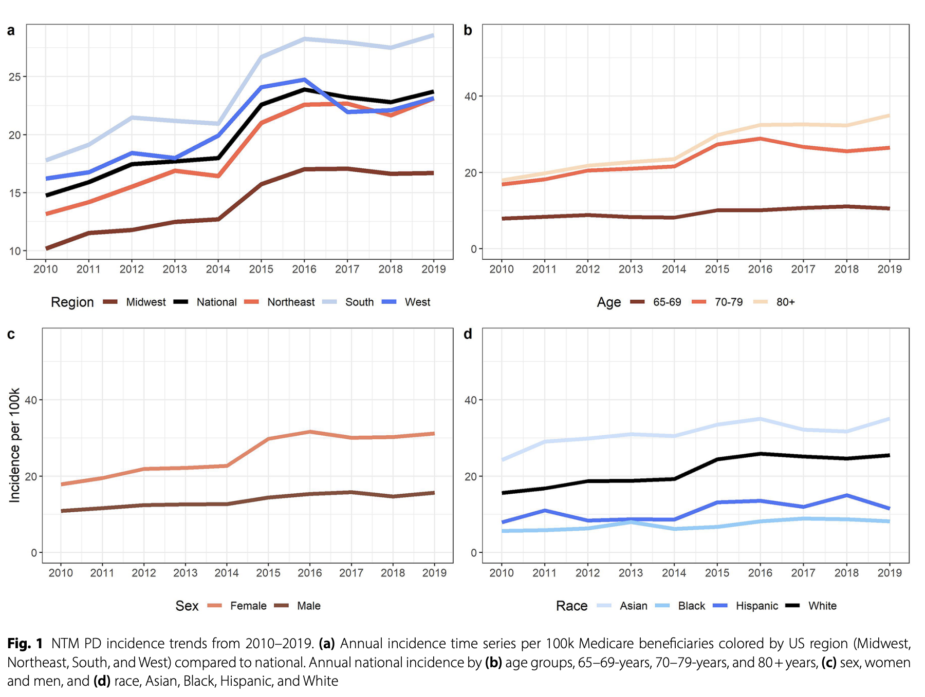
Increasing trends in NTM Medicare data 2010-2019
Bents et al. BMC Infectious Diseases (2024) 24:1094
Notes:
South-coastal regions, age-older individuals, F>M, race Asian/white. Pacific islanders in Hawaii

Slide 8
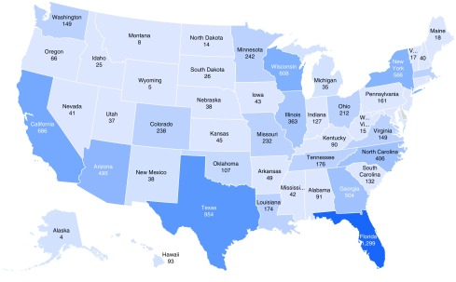
Incidence of NTM by state
Number of patients by state at the first diagnosis of nontuberculous mycobacterial (NTM) lung disease, January 1, 2007, to June 30, 2016 (N = 9,476).
Winthrop KL et al. Ann AM Thorac Soc. 2020 Feb;17(2):178–185. doi: 10.1513/AnnalsATS.201804-236OC
Notes:
Increasing prevalence of 8.2%/year, coastal regions >water vapor content. Example HI/Florida

Slide 9
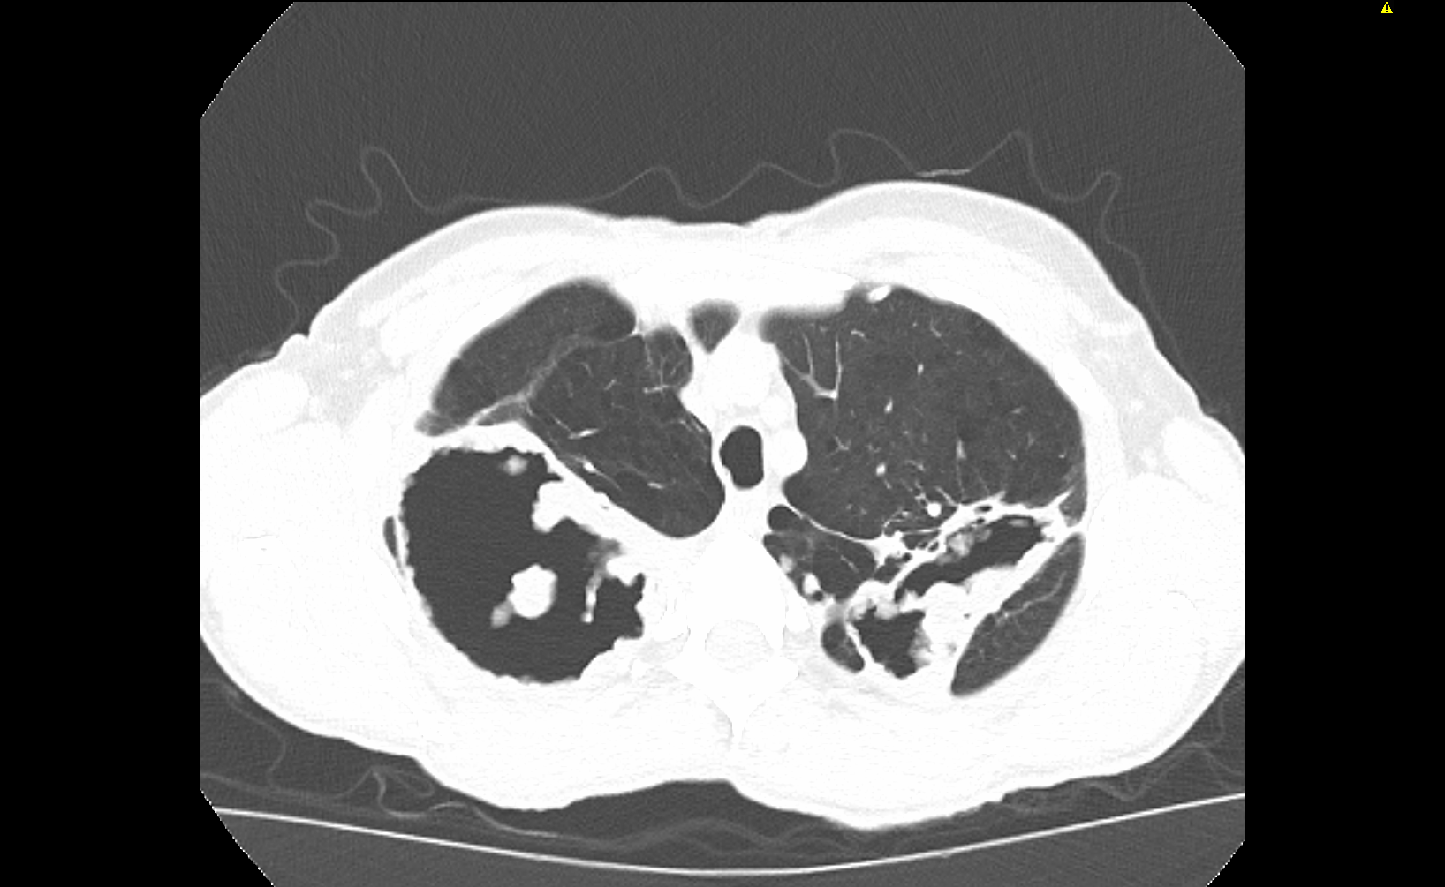
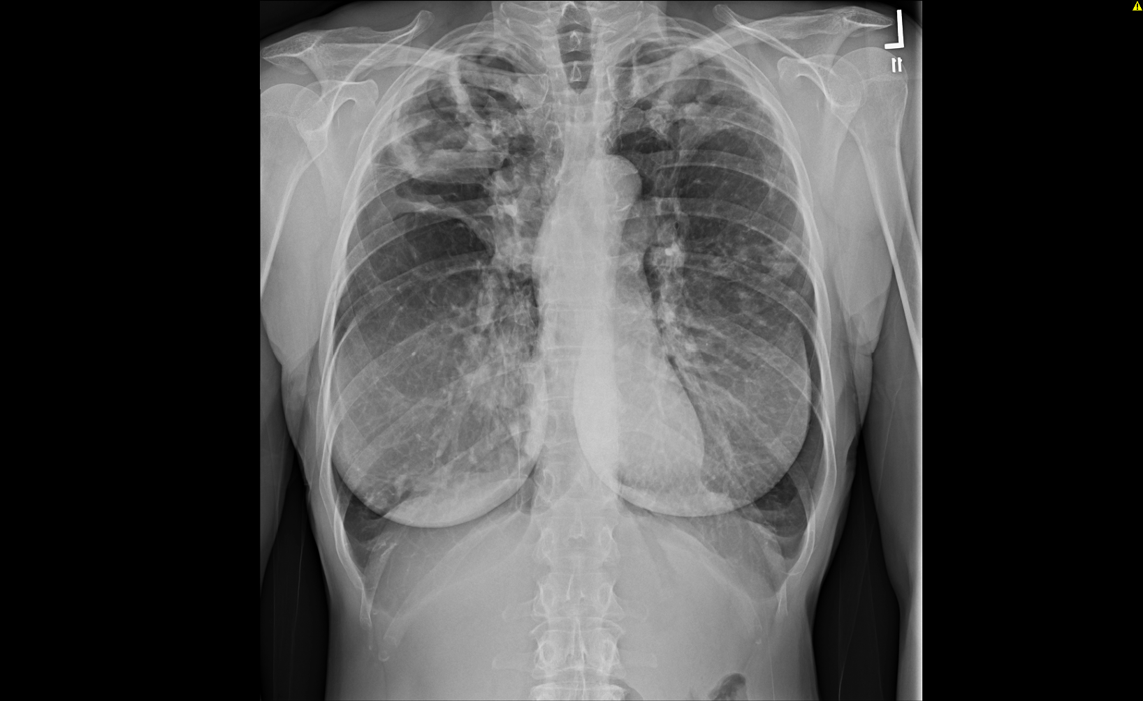
Clinical Phenotypes
Fibrocavitary disease
Male
Older
Smokers
Various body builds
Upper lobe predominant
Kim RD, et al. AJRCCM 2008:178:1066-1047
Notes:
2 classic phenotypes
This has not changed

Slide 10
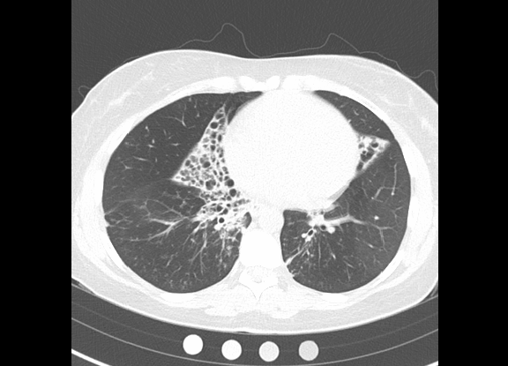
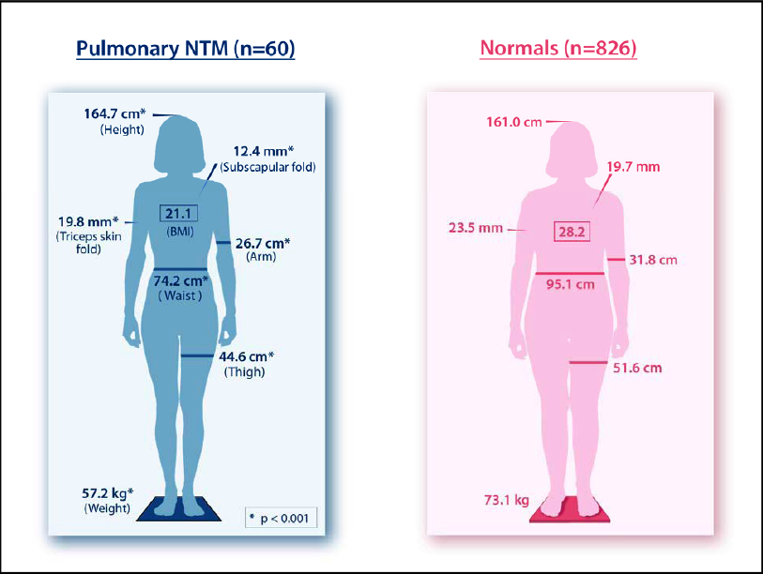
Clinical Phenotypes
Nodular/bronchiectatic disease
Women
Non smokers
Tall, thin, low body mass index
RML, lingular predominance
Better prognosis
Kim RD, et al. AJRCCM 2008:178:1066-1047

Slide 11
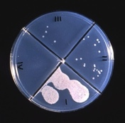
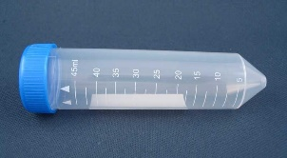
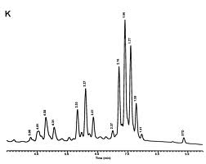
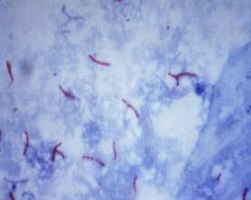
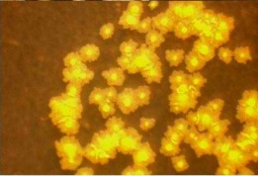
Diagnostic Approaches to NTM-LD and Reducing Time to Treatment
Think about it!
Drug susceptibility
Diagnosis
8-12 weeks!
Collect a specimen
Identification
Microscopic examination
Culture (liquid and solid media)
Notes:
Symptoms are nonspecific: cough, sputum production, fatigue. Average presentation of sx 2 years
Sputum induction-teach airway clearance, ideal 5 ml
Identification-strictly using molecular
Importance of diagnosing bect-gateway two staged

Slide 12
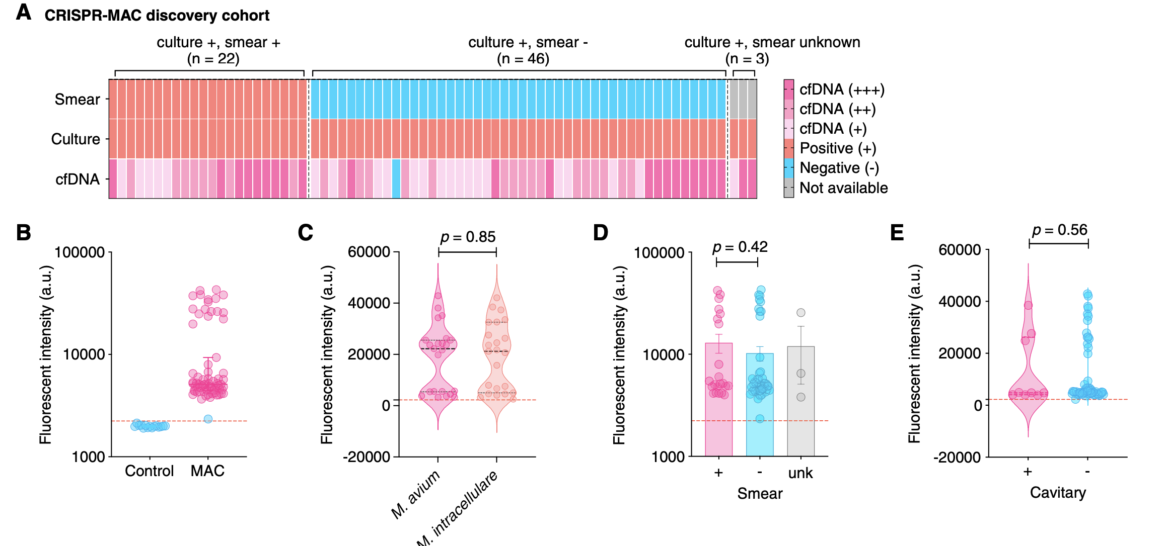
Serum Cell-Free DNA-based Detection of Mycobacterium avium Complex Infection
Sensitivity: 98.6% (CI 92.4-100)
Specificity: 100% (CI 78.2-100)
Li, Lin et al. Am J Respir Crit Care Med 2024 May 15;209(10):1246-1254.
Notes:
Serum cell-free DNA detection-involves analyzing DNA fragments circulating freely in blood serum.
Early detection monitoring of treatment response prognosis-dz progression

Slide 13
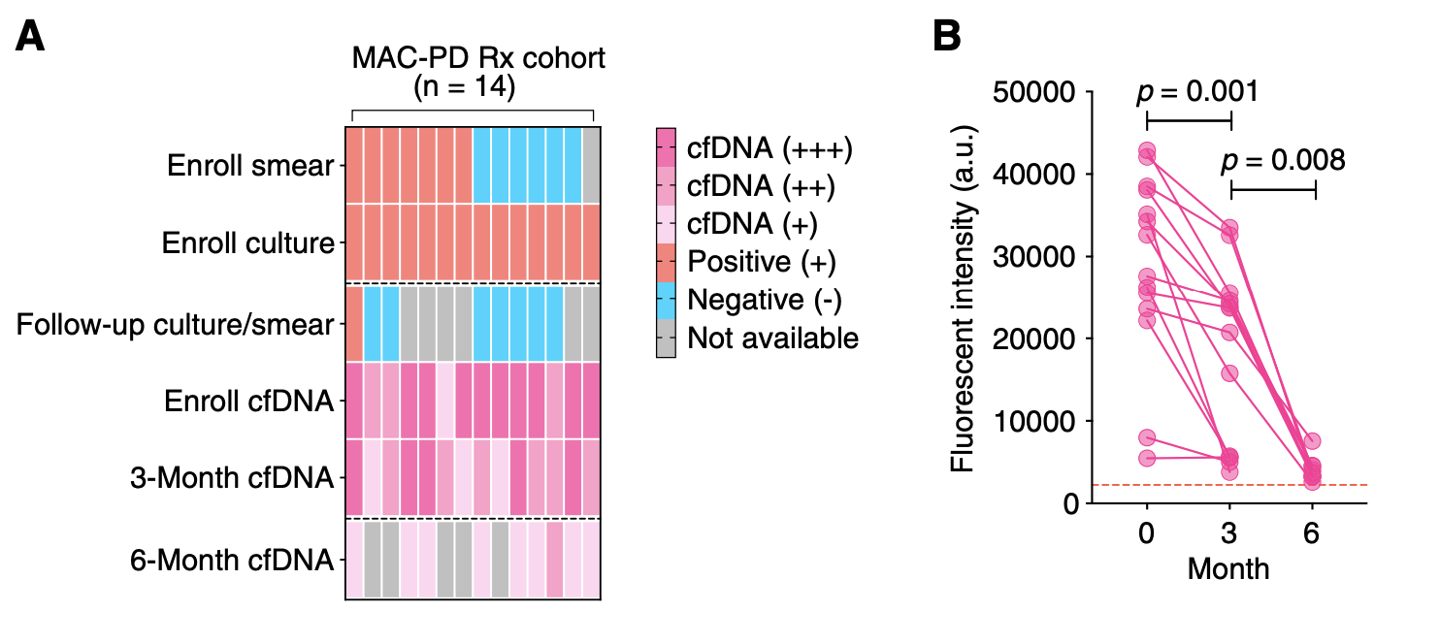
Serum Cell-Free DNA changes after treatment initiation
Li, Lin et al. Am J Respir Crit Care Med 2024 May 15;209(10):1246-1254.
Notes:
Bacterial burden decreased on treatment

Slide 14
Why Early Diagnosis and Reducing Time to Treatment is Important
Disease progression occurs in ∽ 60% of persons who meet ATS/IDSA diagnostic criteria for disease with 3-5 years
Lung function declines
5-year all cause mortality can be as high as 10-33% than in controls: mortality higher in untreated MAC than treated (33% v 22%)
Hwang JA, et al. Eur Respir J, 2017;49:1600537
Kwon BS, et al. Respir Med 2019;150:45-50
Moon SM, et al. Respir Med 2019;151:1-7
Park HY, et al. Chest 2016;150:1222-1232
Kimuzuka Y, et al. PLoS ONE 2019;14:e0216034
Ito Y, et al. Int J Tuberc Lung Dis 2012;16:408-14
Diel R, et al. BMC Infect Dis 2018;18:206
Jhun BW, et al. Eur Respir J 2020;55:1900798

Slide 15
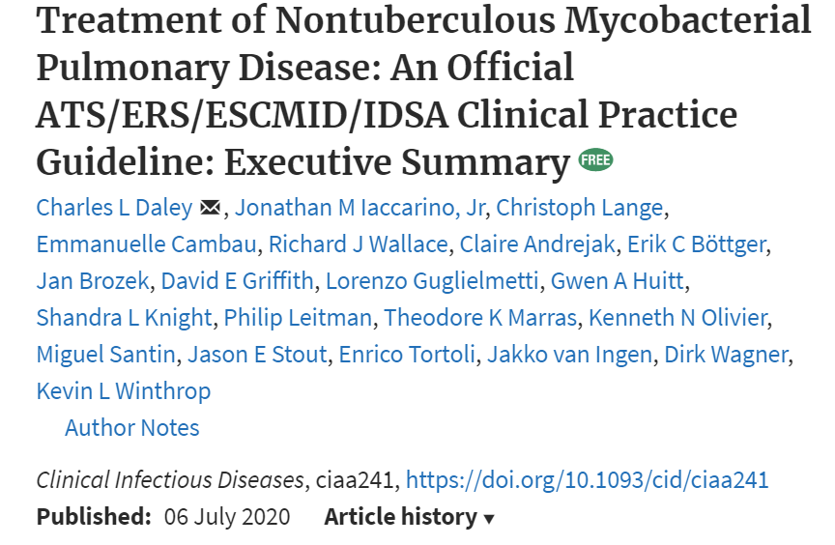
2020 Multi-Society Clinical Practice Guideline
Daley CL, et al. Eur Respir J 2020; 56: 2000535

Slide 16
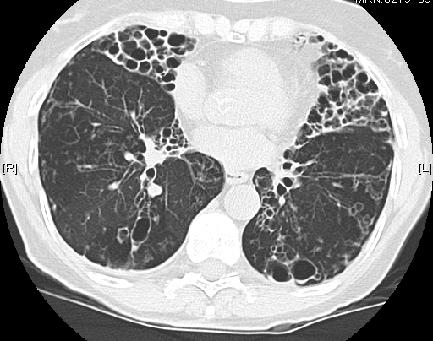
2020 NTM Diagnostic Guidelines
Clinical
Radiographic
Microbiologic
Pulmonary/systemic symptoms:
Cough
Fatigue
Weight Loss
≥ 2 positive sputum cultures
Or 1 positive BAL/wash
Or 1 positive biopsy culture
Daley CL, et al. CID 2020;71:5-913 and Euro Respir J 2020;56:2000535
Notes:
r/o transient exposure example:Jan-MAC Feb-Intracellulare, March-Chimaera DOES NOT meet criteria
Reproducible growing over periods in time
Emphasize cough-long term

Slide 17
Specimen Collection
Bronchoscopy specimens
Sputum
Not as good as you think
  Lidocaine is bacteriostatic
  Specimen is dilute
  Sampling error
  Unable to determine bacterial load
  Risks
  Costs
Better than you think
  Multiple specimens – 3 over at least one week, preferably over weeks
  Sputum AFB smear positivity and number of cultures are associated with progression of NTM disease
  Similar culture yield as bronchoscopy in TB and NTM
  Induction with hypertonic saline is easy! Patients can do it at home
Notes:
Sputum induction-work closely with respiratory therapy
Teaching patients to do induction will help with ongoing surveillance

Slide 18
The factors to consider when initiating treatment
NTM species
-Likelihood of pathogenicity
-Resistance pattern
Severity of disease
-Smear positivity
-Cavitary
Host predictors for progression
-BMI of the patient
-Immune competency
Drugs
-Multiple drugs
-Long duration
-Cost of treatment
Patient priorities
-Few symptoms: cough, fatigue, weight loss
-Quality of life: assessment, good QOL may consider delaying treatment
Daley CL, et al. CID 2020;71:5-913 and Euro Respir J 2020;56:2000535
Notes:
Majority of people this in indolent process

Slide 19
Initiate Treatment or ”Watchful Waiting”?
Recommendation 1
In patients who meet the diagnostic criteria for NTM pulmonary disease, we suggest initiation of treatment rather than watchful waiting, especially in the context of positive acid-fast bacilli sputum smears and/or cavitary lung disease (conditional recommendation, very low certainty in estimates of effect).
Host and organism factors are related to progression of disease
  Some NTM species are more pathogenic than others
  Immunocompromised at greater risk
Cohort studies have reported that bacterial load (i.e., smear positive) and radiographic extent of disease (i.e. cavitary) are predictors of progression
Other predictors are older age, low body mass index (<18.5), co-morbidities, low albumin, anemia, elevated inflammatory indices
488 with MAC-PD
(per ATS)
62.5%
Progressed
23.6%
Stable
51.6%
Spontaneously
culture converted
Daley CL, et al. CID 2020;71:905-913
Hwang JA, et al. Eur Respir J 2017;49:1600537
Notes:
Mild dz, airway clearance, no treatment, convert cultures
Stable patients that culture convert 50% of 23%

Slide 20
Composition of Treatment Regimen
Empiric Treatment vs Susceptibility-based?
Recommendation 2
In patients with MAC pulmonary disease, we suggest susceptibility-based treatment for macrolides and amikacin over empiric therapy (conditional recommendation, very low certainty in estimates of effect).
CONVERT Study – Randomized, controlled study of ALIS in treatment refractory MAC pulmonary disease
Macrolide resistance correlates with poor treatment outcomes.
  Monotherapy trials in HIV-related disseminated MAC
  Retrospective studies in non HIV-related pulmonary disease
  Amikacin resistance associated with specific mutation and worse outcomes
No evidence for other drugs
Daley CL, et al. CID 2020;71:5-913
Olivier KN, et al. Am J Respir Crit Care Med 2017;195:814-823
Notes:
Goal
VERY IMPORTANT of treatment is culture conversion

Slide 21
Role of Antimicrobial Susceptibility Testing (AST)
Species
Drugs
AST for MAC
Macrolide
Rifampicin
M. kansasii
Antimicrobial Agent | MIC, ug/ml
 | S | I | R
Clarithromycin | ≤ 8 | 16 | ≥ 32
Amikacin (IV) | ≤ 16 | 32 | ≥64
Amikacin (liposomal inhaled) | ≤ 64 | - | ≥ 128
Macrolide
Amikacin
MAC
Macrolide
(including erm(41) gene)
Amikacin
M. abscessus
CLSI. M62 Performance Standards for Susceptibility Testing, 2018
Daley CL, et al. CID 2020;71:5-913
Notes:
Know what your lab will give you

Slide 22
Macrolide vs. No Macrolide
Recommendation 3
In patients with MAC pulmonary disease, we recommend a 3-drug regimen that includes a macrolide over a 3-drug regimen without a macrolide (strong recommendation, very low certainty in estimates of effect).
No well-designed studies have addressed this issue
Macrolide susceptibility has been a strong predictor of treatment success
Loss of the macrolide is associated with a markedly reduced rate of sputum culture conversion (5-36%)
Systematic review (21 studies)
Sustained culture conversion incidence rate ratio:
Macrolide-containing 0.54 (0.45-0.63)
Macrolide-free 0.38 (0.25-0.52)
Sputum culture conversion increased in macrolide-containing vs macrolide-free regimens as study quality improved
Daley CL, et al. CID 2020;71:5-913
Pasipanodya JG, et al. J Anti Chemother 2017;72:i3-19

Slide 23
Aminoglycoside vs No Aminoglycoside?
Recommendation 4
For patients with cavitary or advanced/severe bronchiectatic or macrolide-resistant MAC pulmonary disease, we suggest that parenteral amikacin or streptomycin be included in the initial treatment regimen (conditional recommendation, moderate certainty in estimates of effect).
Randomized placebo-controlled study compared macrolide-based 3 drug regimen with IM streptomycin vs placebo
  Higher rate of culture conversion with streptomycin for first 3 mos
Higher culture conversion in those with macrolide resistant disease when an aminoglycoside is included in regimen
P<0.05
Daley CL, et al. CID 2020;71:905-913
Kobashi Y, et al. Resp Med 2007;101:130-138

Slide 24
Inhaled Amikacin?
Recommendation 5
In patients with newly diagnosed MAC pulmonary disease, we suggest neither inhaled amikacin (parenteral formulation) nor amikacin liposome inhalation suspension (ALIS) be used as part of the initial treatment regimen. (conditional recommendation, very low certainty in estimates of effect). In patients with MAC pulmonary disease who have failed therapy after at least six months of guideline-based therapy, we recommend addition of amikacin liposome inhalation suspension (ALIS) to the treatment regimen rather than a standard oral regimen, only. (strong recommendation, moderate certainty in estimates of effect).
CONVERT Study – Randomized, controlled study of ALIS in treatment refractory MAC pulmonary disease
Proportion of Patients With Negative
Sputum Cultures for MAC
Daley CL, et al. CID 2020;71:905-913
Griffith D, et al. AJRCCM 2018;198:1559-1569

Slide 25
Administration of the Regimen
Intermittent vs Daily Therapy?
Recommendation 6
In patients with noncavitary nodular/bronchiectatic macrolide-susceptible MAC pulmonary disease, we suggest a three times per week macrolide-based regimen rather than a daily macrolide-based regimen. (conditional recommendation, very low certainty in estimates of effect). In patients with cavitary or severe/advanced nodular bronchiectatic macrolide-susceptible MAC pulmonary disease, we suggest a daily macrolide-based regimen rather than three times per week macrolide-based regimen. (conditional recommendation, very low certainty in estimates of effect).
Cohort studies have demonstrated similar culture conversion rates with intermittent vs daily therapy
Intermittent therapy has less AEs and better completion rate
No evidence of increased risk of macrolide resistance
Very low rate of culture conversion with intermittent therapy in cavitary MAC
Daley CL, et al. CID 2020;71:905-913

Slide 26
Duration of Therapy?
Recommendation 7
In patients with macrolide-susceptible MAC pulmonary disease, we suggest that patients receive treatment for at least 12 months after culture conversion. (conditional recommendation, very low certainty in estimates of effect).
No randomized studies have evaluated the optimum duration of therapy
Treatment success higher in persons who received at ≥ 12 mos of macrolide-based therapy compared with < 12 mos
Bacteriologic relapse in Japan
  5% when treatment for < 15 mos after sputum culture conversion vs
  0% when treatment for > 15 mos after sputum culture conversion
Daley CL, et al. CID 2020;71:905-913
Kadota JI, et al. Infect Chemother 2017;23:293-300

Slide 27
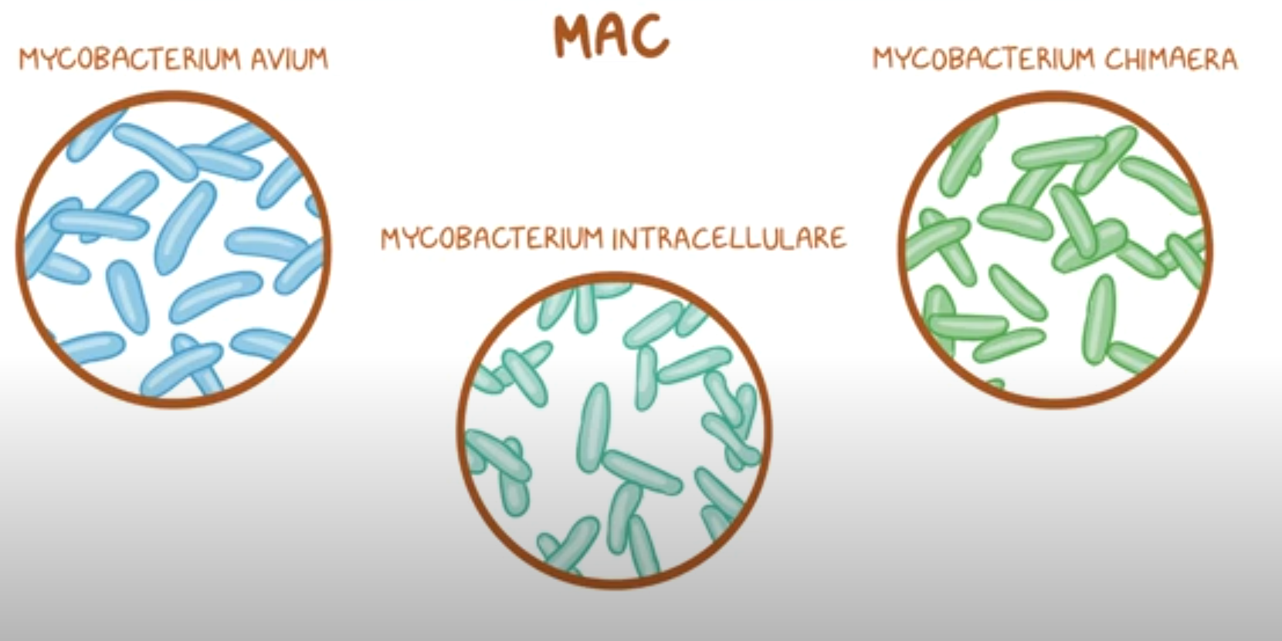
Mycobacterium avium complex (MAC)
Notes:
MAC- 3 species

Slide 28
Mycobacteriology Laboratory Results
Common Report
Preferred Report
Identification: M. avium complex Drug susceptibility: Amikacin R Clarithromycin S Rifampin S Ethambutol R Linezolid R Moxifloxacin I | Identification: 100 colonies of M. intracellulare ssp chimaera Drug Susceptibility: MIC Amikacin 8 Clarithromycin 2 Linezolid 32 Moxifloxacin 2 Clofazimine 0.25

Slide 29
Recommended Treatment Regimens
MAC
 | No. of Drugs | Preferred Regimenª | Dosing Frequency
Nodular-bronchiectatic | 3 | Azithromycin (clarithromycin) Rifampicin (rifabutin) Ethambutol | 3 times weekly
Cavitary | ≥ 3 | Azithromycin (clarithromycin) Rifampicin (rifabutin) Ethambutol Amikacin IV (streptomycin)^{b} | Daily (IV aminoglycoside may be used 3 times weekly)
Refractory^{c} | ≥ 4 | Azithromycin (clarithromycin) Rifampicin (rifabutin) Ethambutol Amikacin liposome inhalation suspension or IV (streptomycin)^{b} | Daily (IV aminoglycoside may be used 3 times weekly)
a. Alternative drugs could include clofazimine, moxifloxacin, linezolid (tedizolid), bedaquiline
b. Consider for cavitary, extensive nodular bronchiectatic or macrolide resistant disease
c. Sputum culture positive after 6 months of guideline-based therapy
Daley CL, et al. CID 2020;71:905-913
Notes:
3x/week treatment larger dose ethambutol (25mg/kg)
Weight<50kg consider rifampin 450 mg daily

Slide 30
Treatment of MAC Pulmonary Disease
MAC
Duration :12 mos culture negativity
Macrolide
sensitive
Yes
No
Cavities Present
Clofazimine
Moxifloxacin
Bedaquiline
Inh. amikacin
Other drugs?
DAILY
Rifampin
Ethambutol
Other drug
Yes
No
DAILY
Azithromycin*
Rifampin
Ethambutol
3X/week
Azithromycin*
Rifampin
Ethambutol
* clarithromycin
Add IV Amikacin

Slide 31
Adverse Reactions and Monitoring for selected agents
Drug | Adverse Reactions | Monitoring
Azithromycin | Gastrointestinal Hepatotoxicity Prolonged QTc Tinnitus/hearing loss | LFTs, EKG, audiogram Clinical monitoring
Ethambutol | Optic neuropathy Peripheral Neuropathy | Visual Acuity/color discrimination testing Clinical monitoring
Rifampin/Rifabutin | Cytopenias Hepatotoxicity hypersensitivity | CBC, LFTs Clinical Monitoring
Amikacin (intravenous) | Electrolyte disturbances Ototoxicity Nephrotoxicity Vestibular toxicity | Calcium, magnesium, potassium Audiograms BUN, creatinine Clinical monitoring
Amikacin (liposomal, inhaled) | Cough, dyspnea, dysphonia, vestibular toxicity Ototoxicity nephrotoxicity | Audiograms BUN, creatinine Clinical monitoring Daley. Clin Infect Dis. 2020;71:905

Slide 32
MAC: Summary
MAC pulmonary disease should be treated with a macrolide-based regimen
An aminoglycoside should be considered in cavitary disease and when macrolide resistance is present
The optimal duration of therapy is not know but should be at least 12 months beyond the point of culture conversion
Macrolide susceptible MAC is usually cured
In treatment refractory MAC, amikacin liposome inhalation suspension (ALIS) should be added to guideline-based therapy
Recurrences are common and usually due to reinfection with another strain (or species)

Slide 33

Mycobacterium abscessus

Slide 34
Macrolide susceptibility differs between subspecies
M. abscessus subspecies | CLR susceptibility days 3–5 | CLR susceptibility day 14 | Macrolide susceptibility phenotype | Genetic implication | Macrolide Effect
massiliense (abscessus*) | Susceptible | Susceptible | Macrolide susceptible | dysfunctional erm(41) gene | Anti-mycobacterial
abscessus bolletii | Susceptible | Resistant | Inducible macrolide resistance | functional erm(41) gene | Immuno-modulatory
Any | Resistant | Resistant | High-level constitutive macrolide resistance | 23S ribosomal RNA point mutation | Immuno-modulatory
*15-20% of M.abscessus subsp.abscessus have a dysfunctional ERM41 (C28)
CLR: Clarithromycin
Haworth C, et al. Thorax 2017;72(Suppl 2):ii1
Notes:
You cannot manage these patients without the help of a lab

Slide 35
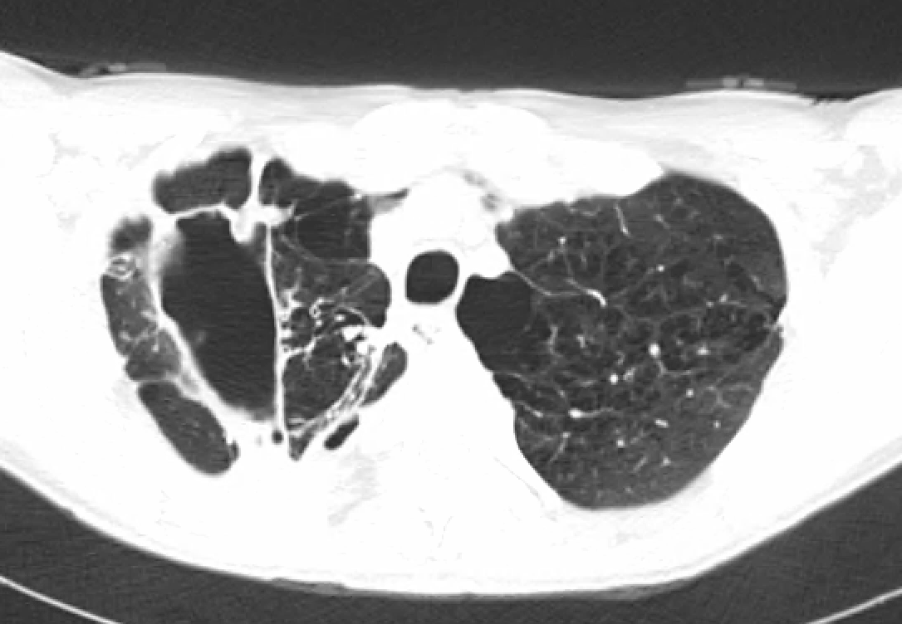
Predictors of progression
N=113 median follow up 3.4 years, Seoul National University
37% of MAB group and 38% of MMA group progressed requiring treatment.
Bilateral disease
Cavitary disease
Cavitary disease
OR 4.79 (1.39–16.48)
p 0.13
OR 3.83 (1.06–13.82)
p 0.04
OR 3.62 (1.02–12.82)
p 0.46
MAB: M. abscessus subspecies abscessus MMA: M. abscessus subspecies massiliense
Park J, et al. CID. 2017 Feb 1;64(3):301-308.
Notes:
N 113
Median f/u of 3.4 years. 37% of MAB group and 38% of MMA group progressed requiring treatment.
No difference in progression between subspecies MAB vs. MMA (Seoul National University Park et al)

Slide 36
Predictors of a favorable outcome
Culture conversion
BMI >18.5
Macrolide susceptible
Smooth morphotype
Specific drugs used
Surgical
resection
Non –cavitary disease
Park J, et al. Clin Infect Dis. 2017 Feb 1;64(3):301-308
Park J, et al. Respir Med. 2021 Oct;187:106549
Notes:
Smooth environmental >hope cx conversion
Rough >virulent

Slide 37
Mycobacteriology Laboratory Results
Preferred Report
Identification:
200 colonies of M. abscessus,
subspecies abscessus
erm(41) – present, T28C mutation
Drug susceptibility: MIC
Amikacin 8
Cefoxitin 16
Clarithromycin 1
Imipenem 16
Tigecycline 0.125
Clofazimine <0.5
Common Report
Identification:
M. chelonae-abscessus group
Drug susceptibility:
Amikacin R
Cefoxitin I
Clarithromycin S
Tigecycline S
Notes:
Common report is NOT acceptable

Slide 38
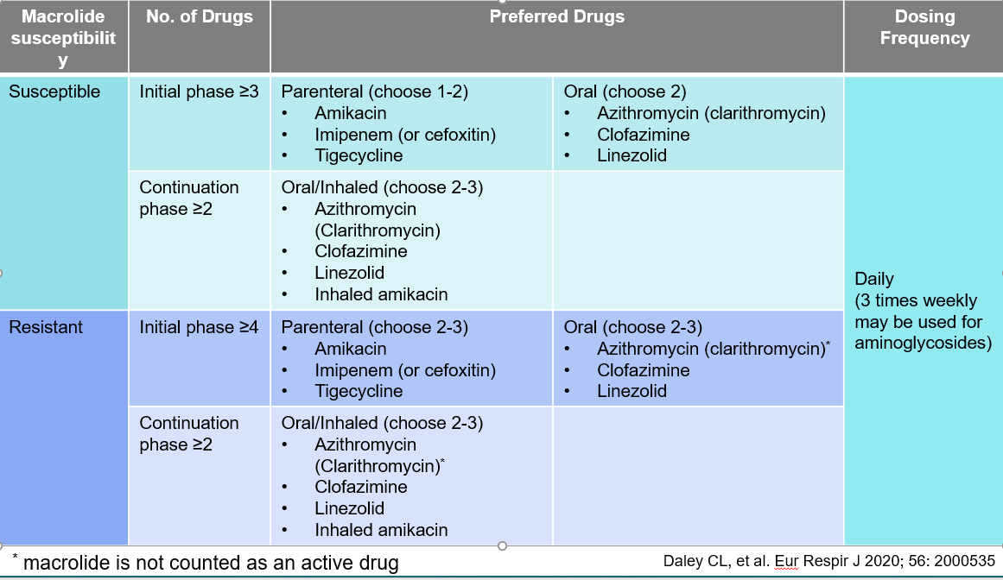
Treatment Regimens for M. abscessus

Slide 39
M. abscessus: Summary
M. abscessus has high levels of in vitro resistance to many antibiotics
Treatment requires a combination of intravenous, oral, and inhaled antibiotics
Treatment outcomes are usually good when the erm(41) gene is not functional
Most recurrences appear to be due to reinfection or another species
Surgical resection may increase bacteriologic conversion

Slide 40
Indications for surgery in NTM PD
Failure of medical therapy
Recurrent infection
Antibiotic resistance-macrolide/aminoglycoside
Antibiotic intolerance
Symptom control- hemoptysis
Limit disease progression- bronchiectasis
Mitchell JD. Thorac Surg Clin (2019) 77-83
Notes:
Adjunctive surgical resection- NEED to be on antimicrobial treatment typically 8 weeks prior
Focal parenchymal disease

Slide 41
Airway Clearance
Short term goals | Longer term goals
Provide effective sputum clearance | Reduce further airway damage
Improve ventilation | Halt cycle of bacterial colonization and inflammation
Reduce cough | Reduce number of pulmonary exacerbations and hospitalizations
Reduce breathlessness | Improve quality of life (HRQol)
O’Neill K et al, Respirology (2019) 24, 227 237doi: 10.1111/resp.13459
Notes:
OPEP device
HTS 7%
OLE-volera

Slide 42
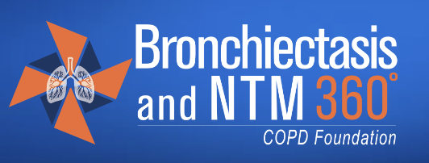
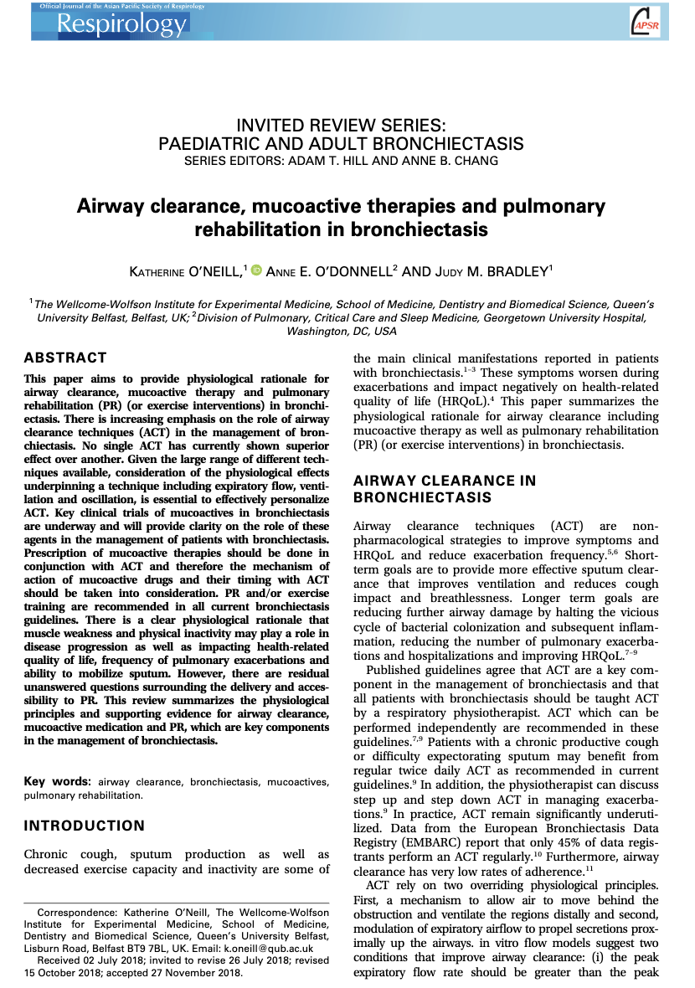

Remember Airway Clearance
Inflammation
Airway
Clearance
=
Lung Infection
Mucus Production
www.bronchiectasisandntminitiative.org
www.bronchiectasis.com.au
www.rethinkbronchiectasis.com
www.impact-be.com
O’Neill K et al, Respirology (2019) 24, 227-237doi: 10.1111/resp.13459

Slide 43
Managing NTM Lung Disease requires specialist care and a Mulitdisciplinary Approach
Advanced Practice Provider (APPs) | Nurses
Pulmonologists | Pharmacists
Infectious Disease Specialists | Ophthalmologists
Primary Care Physician (PCP) | Audiologists
Respiratory Therapists | Surgeons
Radiologists | Dietitians/nutritionists
Microbiologists | Mental Health Care Providers

