Slide 2
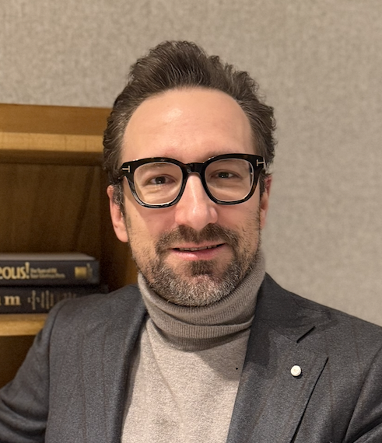
HONOREE
Federico Checo
Chief Executive Officer
Prestige Wellness Group Inc.

Slide 3
GALA CHAIR
Jennifer Widay
Kaback Service, Inc.

Slide 4
LEADERSHIP COMMITTEE
Madison P. Arent Covington & Burling LLP
Franchesco Belcaro Radikal House Samuel A. Gelman Ten-X
Cassandra L. Siegel Neubauer

Slide 5
LEADERSHIP COMMITTEE
Kriish Parekh Deutsche Bank Alexander P. Riguardi Jones Lang LaSalle
Josh Shapiro RWN Real Estate Partners LLC
Harlan Strader III Silverstein Properties LLC

Slide 6
CHAIRS EMERITI
Kathy A. Chazen, CLU, ChFC
Trustee, National Jewish Health
Roger A. Silverstein
Silverstein Properties, Inc.
Trustee, National Jewish Health

Slide 7
NATIONAL JEWISH HEALTH SPEAKER
Jennifer McCullough, M.S.Ed.
Director of Education, Morgridge Academy

Slide 8
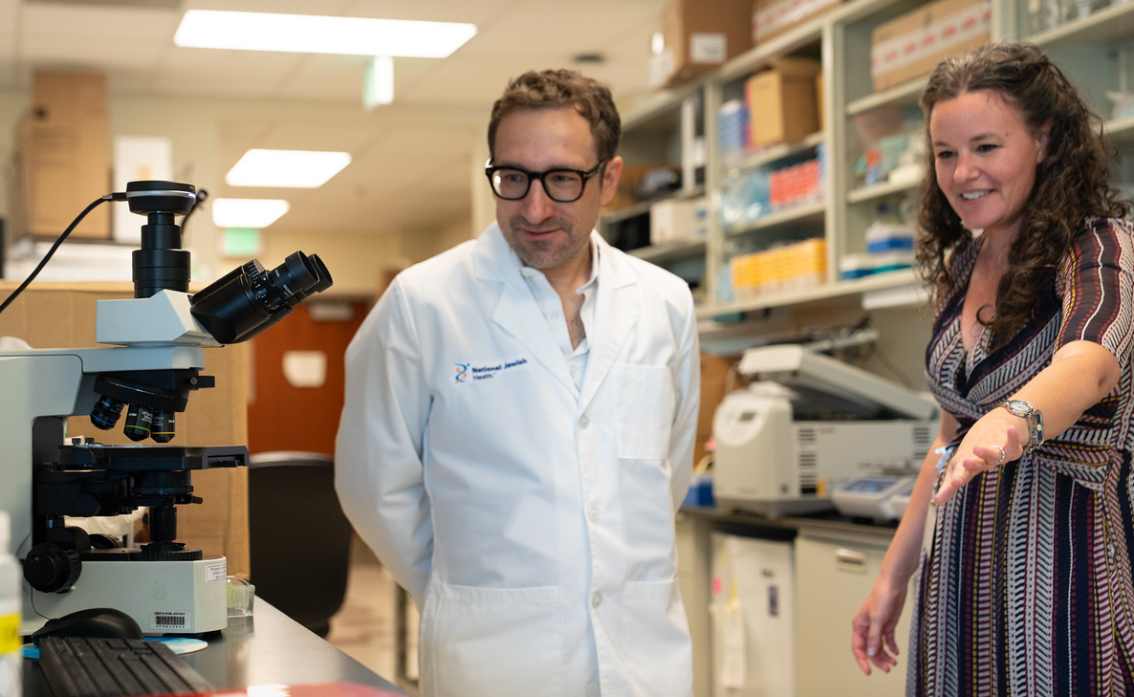
Federico Visits the National Jewish Health Lab of Researcher Elizabeth Redente, PhD.

Slide 9
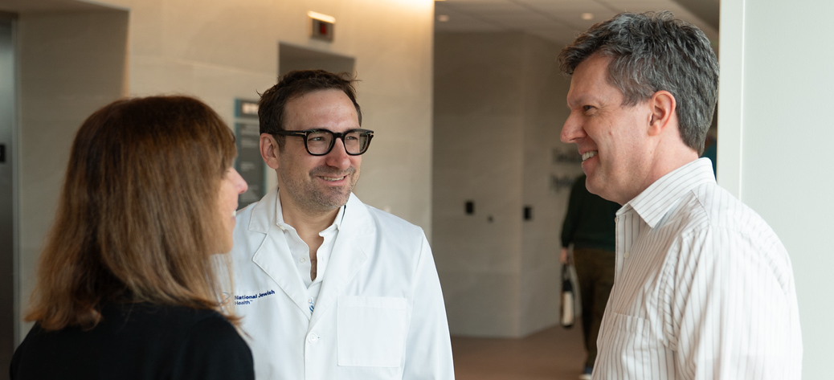
Federico Talks with David Beuther, MD, PhD, Chief Medical Officer, and Lisa Tadiri, Vice President for Development, at National Jewish Health.

Slide 11






PLATINUM SPONSORS

Slide 12

PLATINUM SPONSOR

Slide 13

PLATINUM SPONSOR

Slide 14

PLATINUM SPONSOR

Slide 15

PLATINUM SPONSOR

Slide 16
PLATINUM SPONSOR

Slide 17

PLATINUM SPONSOR
Silverstein Dream Foundation is proud to support
THE AIR SOCIETY
And congratulates
FEDERICO CHECO
On being the 2026 honoree and receiving the Irving Borenstein Award
Patricia & Roger Silverstein

Slide 18
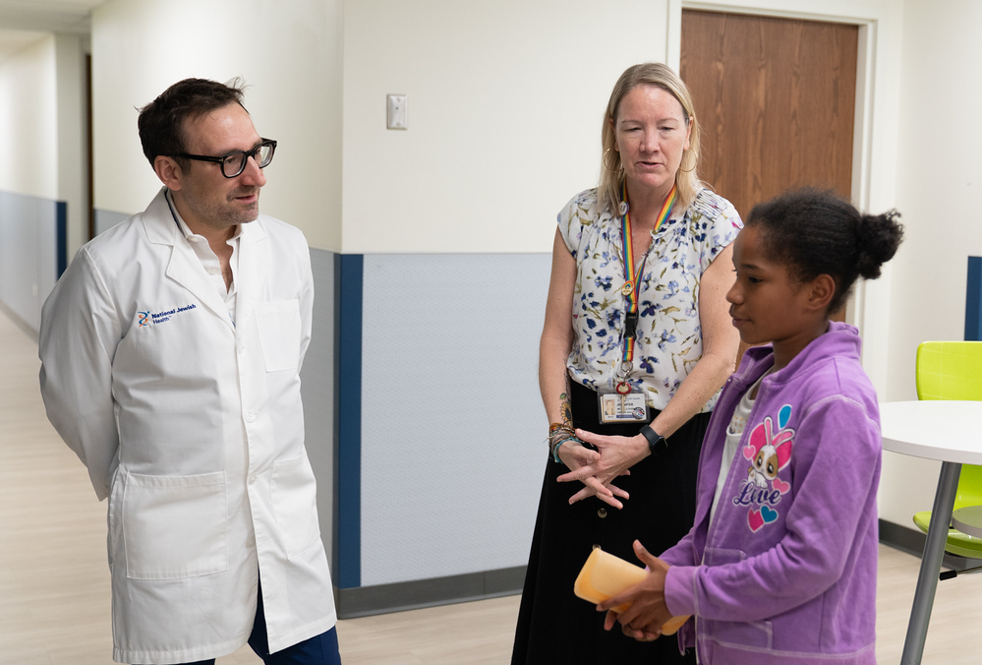
Federico Meets Director of Education Jennifer McCullough, M.S. Ed. and a Student at National Jewish Health Morgridge Academy.

Slide 20





GOLD SPONSORS
Carrie & Brian Packin
Esther Koven Charity
Foundation

Slide 21

GOLD SPONSOR

Slide 22
GOLD SPONSOR

Slide 23
GOLD SPONSOR
Esther Koven Charity
Foundation

Slide 24

GOLD SPONSOR

Slide 25

GOLD SPONSOR

Slide 26
GOLD SPONSOR
Carrie & Brian Packin

Slide 27

GOLD SPONSOR

Slide 28
GOLD SPONSOR
WILK AUSLANDER LLP
Takes Pride in Honoring
FEDERICO CHECO
For his Commitment to
THE NEW YORK
AIR SOCIETY
and
NATIONAL JEWISH HEALTH

Slide 29
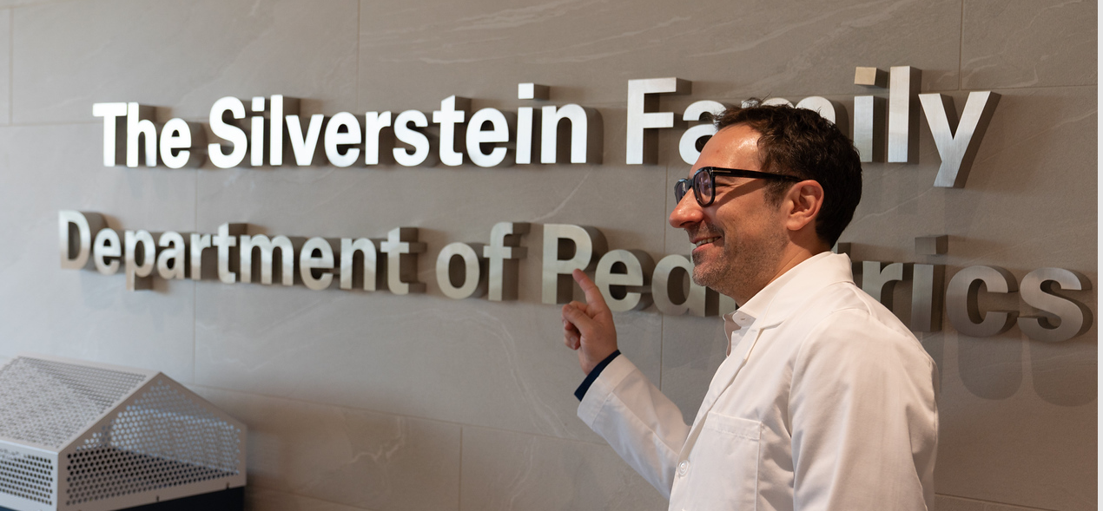
Federico Tours National Jewish Health in Denver

Slide 31






SILVER SPONSORS

Slide 32


SILVER SPONSOR

Slide 33

SILVER SPONSOR

Slide 34

SILVER SPONSOR

Slide 35
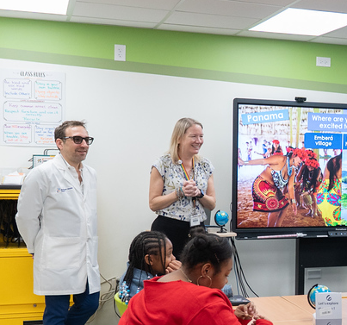
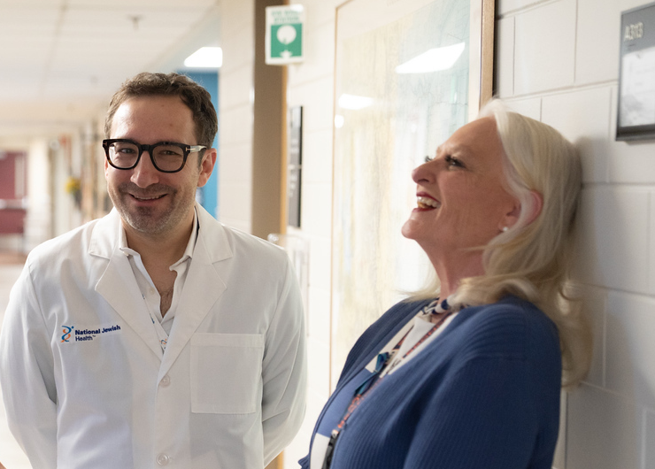
Federico Visits Morgridge Academy Classroom
Federico Visits with the Director of Pulmonary Physiology Unit

Slide 36


